Slide 1
Turing’s Thesis
Costas Busch - LSU

Slide 2
Turing’s thesis (1930):
Any computation carried out
by mechanical means
can be performed by a Turing Machine
Costas Busch - LSU

Slide 3
Algorithm:
An algorithm for a problem is a
Turing Machine which solves the problem
The algorithm describes the steps of
the mechanical means
This is easily translated to computation steps
of a Turing machine
Costas Busch - LSU

Slide 4
When we say:
There exists an algorithm
We mean:
There exists a Turing Machine
that executes the algorithm
Costas Busch - LSU

Slide 5
Variations of the
Turing Machine
Costas Busch - LSU

Slide 6




The Standard Model
Infinite Tape
Read-Write Head
(Left or Right)
Control Unit
Deterministic
Costas Busch - LSU

Slide 7
Variations of the Standard Model
Turing machines with:
Stay-Option
Semi-Infinite Tape
Multitape
Multidimensional
Nondeterministic
Different Turing Machine Classes
Costas Busch - LSU

Slide 8
Same Power of two machine classes:
both classes accept the
same set of languages
We will prove:
each new class has the same power
with Standard Turing Machine
(accept Turing-Recognizable Languages)
Costas Busch - LSU

Slide 9
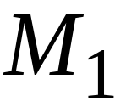
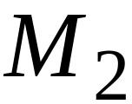
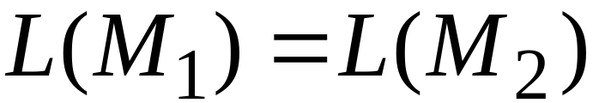
Same Power of two classes means:
for any machine of first class
there is a machine of second class
such that:
and vice-versa
Costas Busch - LSU

Slide 10
Simulation:
A technique to prove same power.
Simulate the machine of one class
with a machine of the other class
Second Class
Simulation Machine
First Class
Original Machine
simulates
Costas Busch - LSU

Slide 11
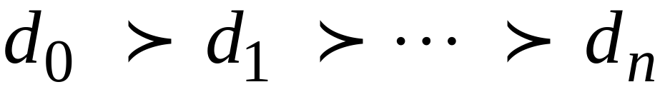
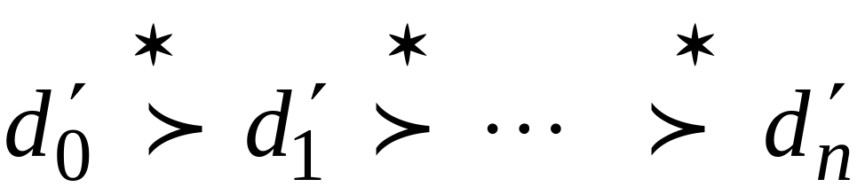
Configurations in the Original Machine
have corresponding configurations
in the Simulation Machine
Original Machine:
Simulation Machine:
Costas Busch - LSU

Slide 12
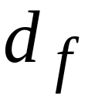
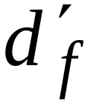
Accepting Configuration
Original Machine:
Simulation Machine:
the Simulation Machine
and the Original Machine
accept the same strings
Costas Busch - LSU

Slide 13
Turing Machines with Stay-Option
The head can stay in the same position
Left, Right, Stay
L,R,S: possible head moves
Costas Busch - LSU

Slide 14



Example:
Time 1
Time 2
Costas Busch - LSU

Slide 15
Theorem:
Stay-Option machines
have the same power with
Standard Turing machines
Proof:
1. Stay-Option Machines
simulate Standard Turing machines
2.
Standard Turing machines
simulate Stay-Option machines
Costas Busch - LSU

Slide 16
1. Stay-Option Machines
simulate Standard Turing machines
Trivial: any standard Turing machine
is also a Stay-Option machine
Costas Busch - LSU

Slide 17
2.
Standard Turing machines
simulate Stay-Option machines
We need to simulate the stay head option
with two head moves, one left and one right
Costas Busch - LSU

Slide 18




Stay-Option Machine
Simulation in Standard Machine
For every possible tape symbol
Costas Busch - LSU

Slide 19
For other transitions nothing changes
Stay-Option Machine
Simulation in Standard Machine
Similar for Right moves
Costas Busch - LSU

Slide 20

example of simulation
Stay-Option Machine:
1
2
Simulation in Standard Machine:
1
2
3
END OF PROOF
Costas Busch - LSU

Slide 21

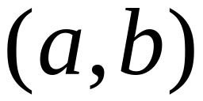
A useful trick: Multiple Track Tape
helps for more complicated simulations
One Tape
track 1
track 2
One head
One symbol
It is a standard Turing machine, but each tape alphabet symbol
describes a pair of actual useful symbols
Costas Busch - LSU

Slide 22
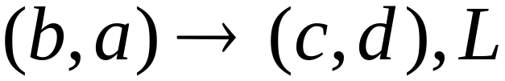
track 1
track 2
track 1
track 2
Costas Busch - LSU

Slide 23
Semi-Infinite Tape
The head extends infinitely only to the right
.........
Initial position is the leftmost cell
When the head moves left from the border,
it returns back to leftmost position
Costas Busch - LSU

Slide 24
Theorem:
Semi-Infinite machines
have the same power with
Standard Turing machines
Proof:
1.
Standard Turing machines
simulate Semi-Infinite machines
2. Semi-Infinite Machines
simulate Standard Turing machines
Costas Busch - LSU

Slide 25


1. Standard Turing machines simulate
Semi-Infinite machines:
.........
.........
Standard Turing Machine
Semi-Infinite machine modifications
a. insert special symbol
at left of input string
b. Add a self-loop
to every state
(except states with no
outgoing transitions)
Costas Busch - LSU

Slide 26
2. Semi-Infinite tape machines simulate
Standard Turing machines:
Standard machine
.........
.........
Semi-Infinite tape machine
.........
Squeeze infinity of both directions
to one direction
Costas Busch - LSU

Slide 27


Standard machine
.........
.........
reference point
Semi-Infinite tape machine with two tracks
Right part
.........
Left part
Costas Busch - LSU

Slide 28
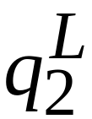
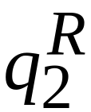
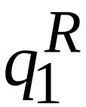
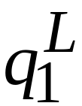
Standard machine
Semi-Infinite tape machine
Left part
Right part
Costas Busch - LSU

Slide 29

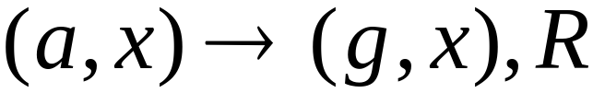
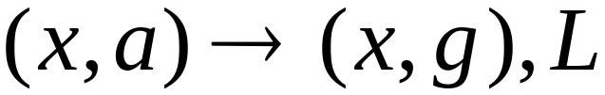

Standard machine
Semi-Infinite tape machine
Right part
Left part
For all tape symbols
Costas Busch - LSU

Slide 30
Time 1
Standard machine
.........
.........
Semi-Infinite tape machine
Right part
.........
Left part
Costas Busch - LSU

Slide 31

Time 2
Standard machine
.........
.........
Semi-Infinite tape machine
Right part
.........
Left part
Costas Busch - LSU

Slide 32
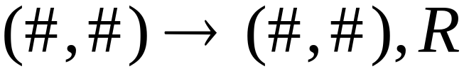
At the border:
Semi-Infinite tape machine
Right part
Left part
Costas Busch - LSU

Slide 33
Semi-Infinite tape machine
Time 1
Right part
.........
Left part
Time 2
Right part
.........
Left part
END OF PROOF
Costas Busch - LSU

Slide 34

Multi-tape Turing Machines
Control unit
(state machine)
Tape 1
Tape 2
Input string
Input string appears on Tape 1
Costas Busch - LSU

Slide 35
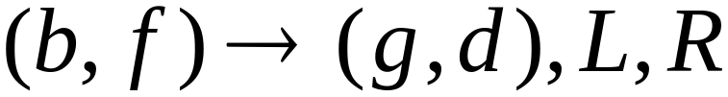
Tape 1
Time 1
Tape 2
Tape 1
Time 2
Tape 2
Costas Busch - LSU

Slide 36
Theorem:
Multi-tape machines
have the same power with
Standard Turing machines
Proof:
1. Multi-tape machines
simulate Standard Turing machines
2.
Standard Turing machines
simulate Multi-tape machines
Costas Busch - LSU

Slide 37
1. Multi-tape machines simulate
Standard Turing Machines:
Trivial: Use one tape
Costas Busch - LSU

Slide 38
2. Standard Turing machines simulate
Multi-tape machines:
Standard machine:
Uses a multi-track tape to simulate
the multiple tapes
A tape of the Multi-tape machine
corresponds to a pair of tracks
Costas Busch - LSU

Slide 39



Multi-tape Machine
Tape 1
Tape 2
Standard machine with four track tape
Tape 1
head position
Tape 2
head position
Costas Busch - LSU

Slide 40
Reference point
Tape 1
head position
Tape 2
head position
Repeat for each Multi-tape state transition:
Return to reference point
Find current symbol in Track 1 and update
Return to reference point
Find current symbol in Tape 2 and update
END OF PROOF
Costas Busch - LSU

Slide 41
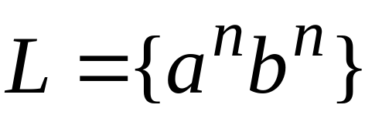
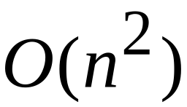
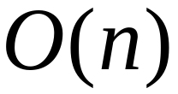
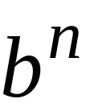
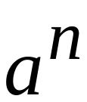
Same power doesn’t imply same speed:
Standard Turing machine:
time
Go back and forth times
to match the a’s with the b’s
2-tape machine:
time
1. Copy to tape 2
( steps)
2. Compare on tape 1
and tape 2
( steps)
Costas Busch - LSU

Slide 42


Multidimensional Turing Machines
2-dimensional tape
MOVES: L,R,U,D
HEAD
U: up D: down
Position: +2, -1
Costas Busch - LSU

Slide 43
Theorem:
Multidimensional machines
have the same power with
Standard Turing machines
Proof:
1. Multidimensional machines
simulate Standard Turing machines
2.
Standard Turing machines
simulate Multi-Dimensional machines
Costas Busch - LSU

Slide 44
1. Multidimensional machines simulate
Standard Turing machines
Trivial: Use one dimension
Costas Busch - LSU

Slide 45
2. Standard Turing machines simulate
Multidimensional machines
Standard machine:
Use a two track tape
Store symbols in track 1
Store coordinates in track 2
Costas Busch - LSU

Slide 46


2-dimensional machine
Standard Machine
symbol
coordinates
Costas Busch - LSU

Slide 47
Standard machine:
Repeat for each transition followed
in the 2-dimensional machine:
Update current symbol
Compute coordinates of next position
Go to new position
END OF PROOF
Costas Busch - LSU

Slide 48

Nondeterministic Turing Machines
Choice 1
Choice 2
Allows Non Deterministic Choices
Costas Busch - LSU

Slide 49
Time 0
Time 1
Choice 1
Choice 2
Costas Busch - LSU

Slide 50

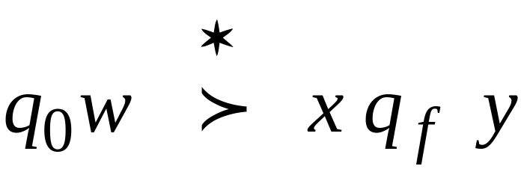
Input string is accepted if
there is a computation:
Initial configuration
Final Configuration
Any accept state
There is a computation:
Costas Busch - LSU

Slide 51
Theorem:
Nondeterministic machines
have the same power with
Standard Turing machines
Proof:
1. Nondeterministic machines
simulate Standard Turing machines
2.
Standard Turing machines
simulate Nondeterministic machines
Costas Busch - LSU

Slide 52
1. Nondeterministic Machines simulate
Standard (deterministic) Turing Machines
Trivial: every deterministic machine
is also nondeterministic
Costas Busch - LSU

Slide 53
2. Standard (deterministic) Turing machines
simulate Nondeterministic machines:
Deterministic machine:
Uses a 2-dimensional tape
(equivalent to standard Turing machine with one tape)
Stores all possible computations
of the non-deterministic machine
on the 2-dimensional tape
Costas Busch - LSU

Slide 54
All possible computation paths
Initial state
Step 1
Step 2
Step i
reject
accept
infinite
path
Step i+1
Costas Busch - LSU

Slide 55
The Deterministic Turing machine
simulates all possible computation paths:
simultaneously
step-by-step
with breadth-first search
depth-first may result getting stuck at exploring
an infinite path before discovering the accepting path
Costas Busch - LSU

Slide 56
NonDeterministic machine
Time 0
Deterministic machine
current
configuration
Costas Busch - LSU

Slide 57

NonDeterministic machine
Time 1
Choice 1
Choice 2
Deterministic machine
Computation 1
Computation 2
Costas Busch - LSU

Slide 58
Deterministic Turing machine
Repeat
  For each configuration in current step
  of non-deterministic machine,
if there are two or more choices:
1. Replicate configuration
2. Change the state in the replicas
Until either the input string is accepted
or rejected in all configurations
Costas Busch - LSU

Slide 59
If the non-deterministic machine accepts
the input string:
The deterministic machine accepts and halts too
The simulation takes in the worst case
exponential time compared to the
shortest length of an accepting path
Costas Busch - LSU

Slide 60
If the non-deterministic machine does not accept the input string:
1. The simulation halts if all paths
reach a halting state
OR
2. The simulation never terminates
if there is a never-ending path (infinite loop)
In either case the deterministic machine
rejects too (1. by halting or 2. by simulating the infinite loop)
END OF PROOF
Costas Busch - LSU

